Slide 1
Umbraco Spark Innovation Conference 2020 Notes by Nurhak Kaya

Slide 2
Agenda
What is Umbraco Spark?
Notes from the talks
Final thoughts & Questions

Slide 3
What is Umbraco Spark?
Umbraco Spark is a Bristol based innovation conference which is a must for all Umbraco developers that want to find out what’s going on with Umbraco, with loads of innovation implementations and ideas.
It features both practical talks on development as well as thought-provoking topics around innovation and forward-thinking.
It is also a great opportunity to meet fellow Umbraco developers from all around the world, including people from Umbraco HQ.

Slide 4
What is Umbraco Spark?
This was the second Umbraco Spark conference and it was held again at M Shed in Bristol.
Some of the speakers were;
Jon Skeet – The ‘Chuck Norris’ of programming and also Stackoverflow Legend
Niels Hartvig – Umbraco Founder aka Chief Unicorn
Bjarke Berg – Senior Developer from Umbraco HQ who is reponsible for moving Umbraco from .NET Framework to .NET Core
Lee Kelleher – Umbraco Specialist and creator of many Umbraco packages
Paul Seal – Umbraco Developer and MVP and creator of many programming blogs/vlogs
Matt Brailsford – Umbraco MVP and Master, also the creator of many Umbraco packages
This is not a free event, it is recommended to purchase the tickets as early as possible, so it can be cheaper.
You can view the full line up of speakers with their presentation slides from Umbraco Spark 2020 on this link.

Slide 5
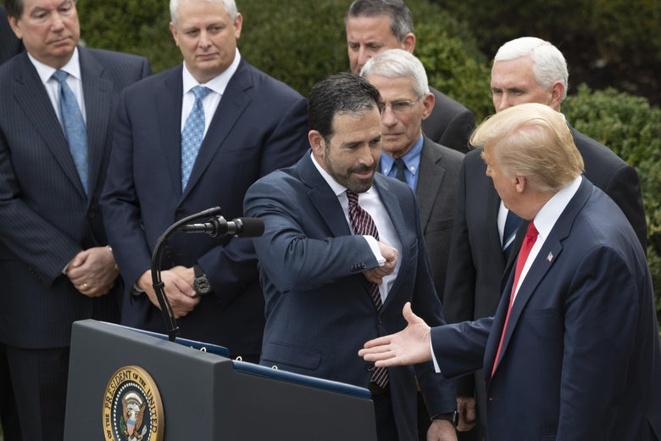
Umbraco Spark 2020
Arriving at the conference
When I got to the venue, I was greeted by the fellow Umbraco people, who were enjoying their breakfast with coffee, also having a nice chat with each other.
I joined them after picking up my name tag and swag, and then headed towards the main conference room, where there were even more people.
After a brief talk and we agreed to greet each other with the foot shake and ‘eye five you rock’, everybody started waiting for Jon Skeet’s talk.

Slide 6
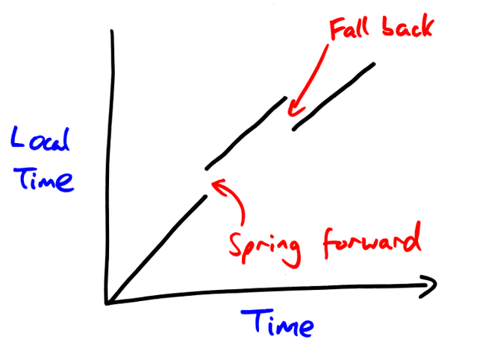
Umbraco Spark 2020
Jon Skeet – Dates and times: Hard, but not impossible
He has written many libraries, as well as NodaTime, which is what the talked about a bit.
One of the important point was; if you are going to support local times, then don’t think you can just store the DateTime.UtcNow, and convert it to the user’s local time! He gave a few examples of when this would break, for instance, during daylight saving time or leap years.

Slide 7
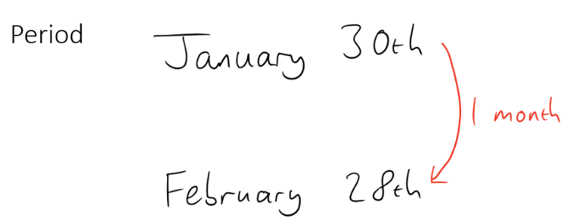
Umbraco Spark 2020
Jon Skeet – Dates and times: Hard, but not impossible
Another good point was about making incorrect assumptions, for example, assuming if you add a month and then substract a month that you would be back to the original date.
If you had the date 30th January 2017 and you tried to add a month like this .AddMonths(1), you would get 28th February 2017 and then if you decided to go back a month using .AddMonths(-1), you wouldn’t be back to where you started, you would be on 28th January 2017.
Things will get even more complicated for countries that use different calender systems; for example; in Saudi Arabia, most events are usually provided with two dates, both the Gregorian and Islamic, and current year is 1441 according to Islamic calendar.

Slide 8
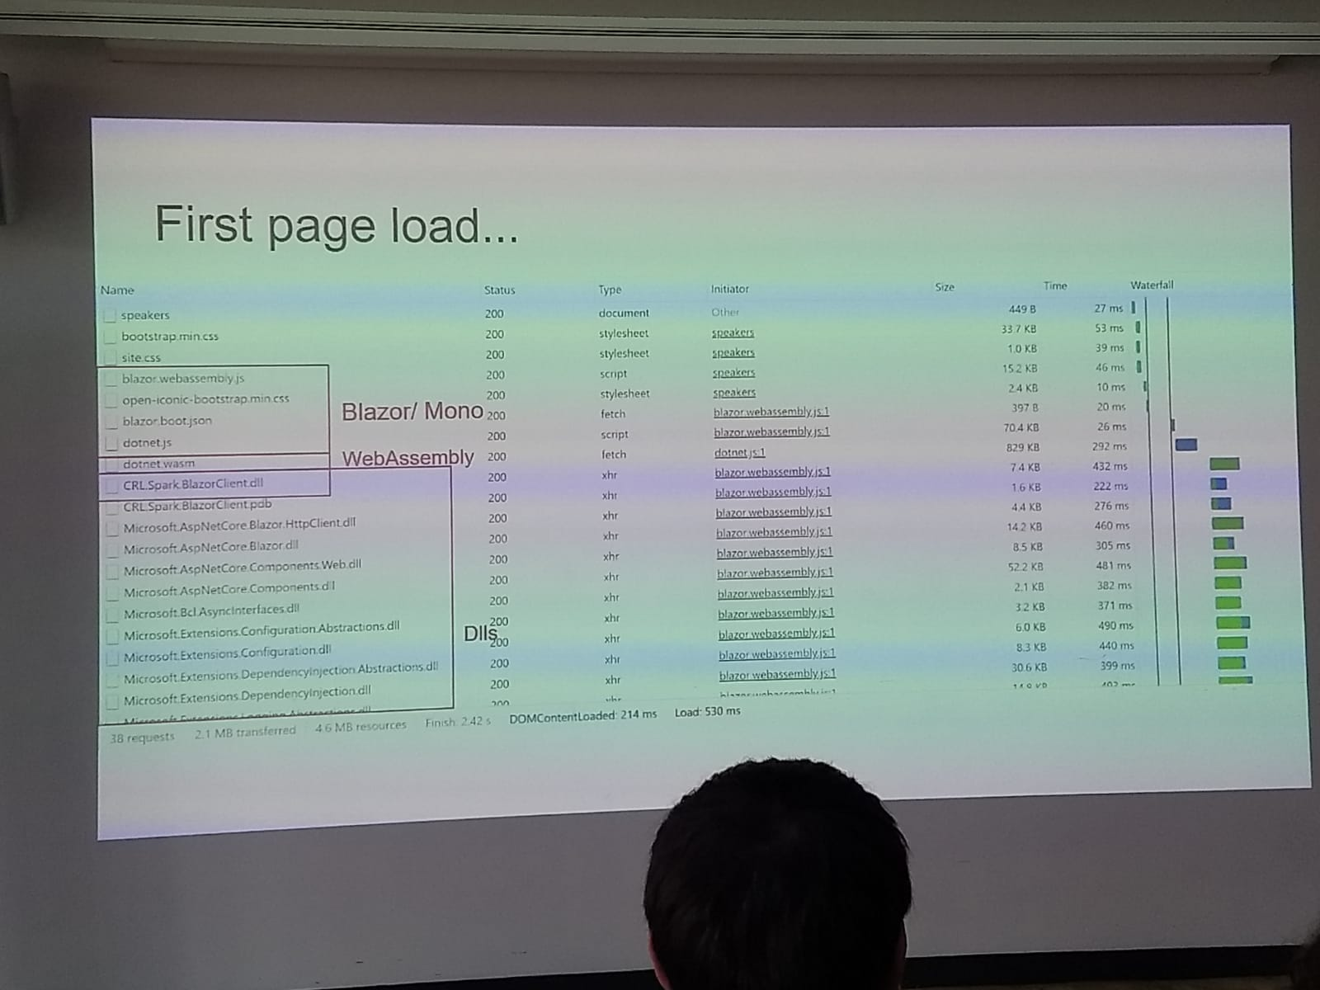
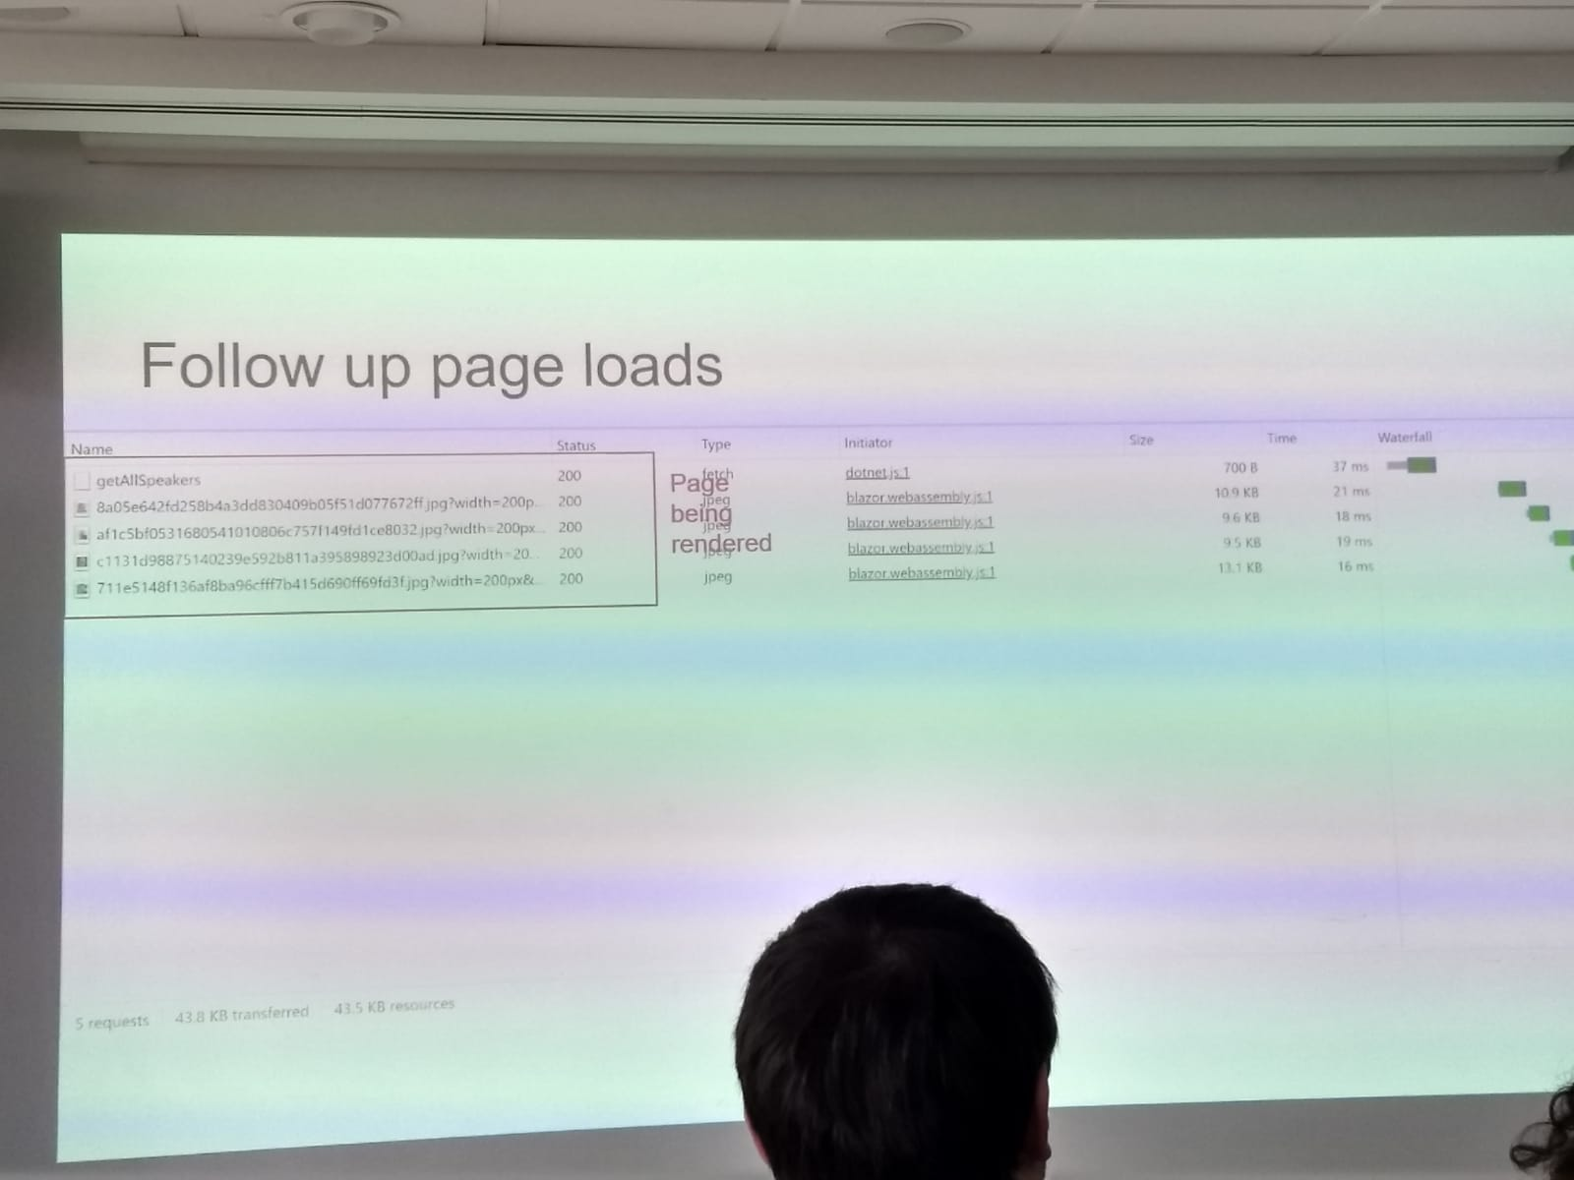
Umbraco Spark 2020
Carole Rennie Logan – An adventure with Blazor & Umbraco
This was an experimental project to see how Blazor could be used with Umbraco.
Carole showed her project structure, details about the page load times and how pages were being rendered with blazor.
One good thing was seeing WebAssembly dlls on the first page load and the speed increase after the first page load.

Slide 9
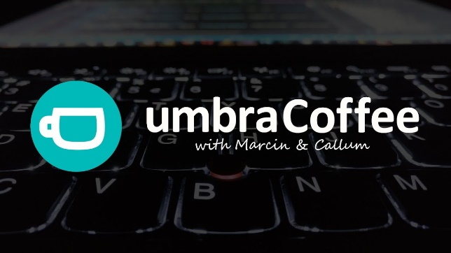
Umbraco Spark 2020
Umbracoffee Live!
If you are both a coffee and Umbraco lover, then this is the weekly online event that you can join every Friday, 11:30 UK local time, which is hosted by Marcin and Callum.
Together with their guests, they drive you through the weekly news and all things Umbraco related. You can ask questions, learn new things or just socialise with other Umbracians. All youtube videos are under this link.
During Umbraco Spark, I had a chance to join my first Umbracoffee event, one of the main topics that was discussed was; "Are we gonna be building Umbraco websites with Blazor?"

Slide 10
Umbraco Spark 2020
Paul Seal & Tim Payne – High performance querying of data in Umbraco v8
Paul and Tim talked about how things have evolved from v4 to v7, and then they shared their performance test results for both v7 and v8. They also talked about changes in v8 and caching, in particular; how caching changes the overall performance.
Conclusions for v7
Friends don’t let friends use the content service (IContentService) on the front end
XPath/XSLT methods are all VERY fast for simple cases
LINQ fine if used wisely
Examine the best method for any meaningful searching/sorting

Slide 11
Umbraco Spark 2020
Paul Seal & Tim Payne – High performance querying of data in Umbraco v8
Changes in v8
V8 content is now stored in a binary cache called NuCache, which lives in /App_Data/TEMP/NuCache.
Every time NuCache is queried, it caches that query in memory
There is a v8 package called : Our.Umbraco.NuCacheExplorer which lets you view the NuCache files from the backoffice.
Content API surface GREATLY reduced
Content Service
Typed Content (can still use Xpath)
Examine (there is a new version available now)

Slide 12
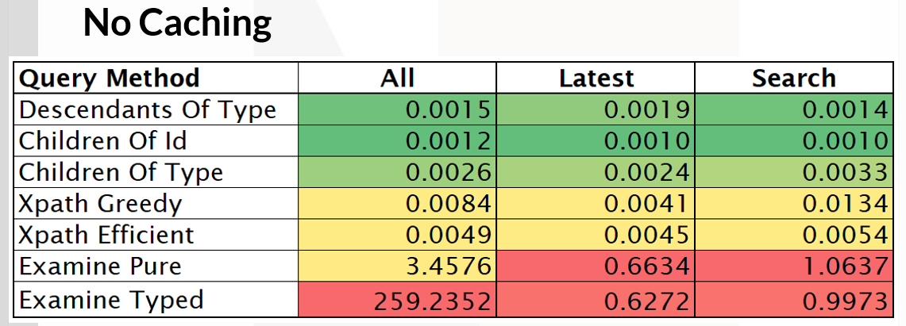
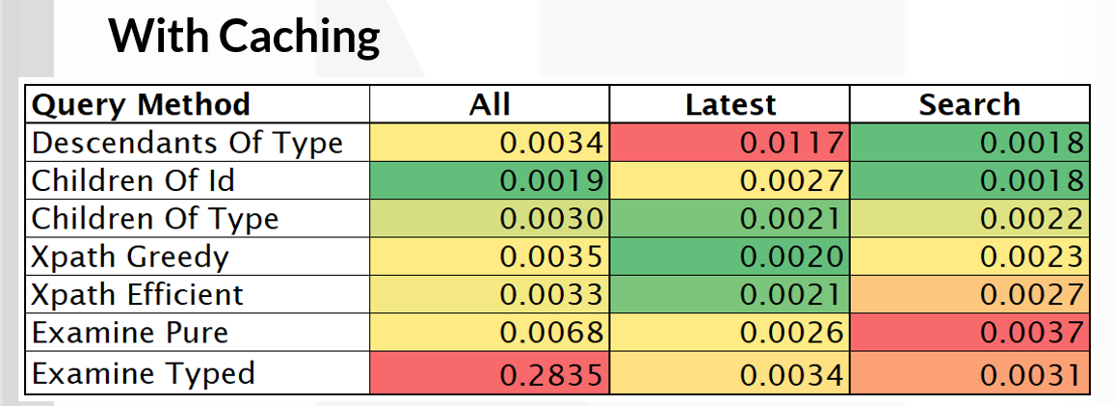
Umbraco Spark 2020
Paul Seal & Tim Payne – High performance querying of data in Umbraco v8
Conculusiton for v8 and Caching
All of the v8 API methods of searching are way faster than in v7.
If you are getting all/latest then it’s faster to use the LINQ methods.
More content = be more careful with LINQ
Examine will perform better on more complicated searches.
XPath is surprisingly fast but this is not meant to be used in v8 anymore.
Caching is good but mainly worth it if you are converting the data to models etc.

Slide 13
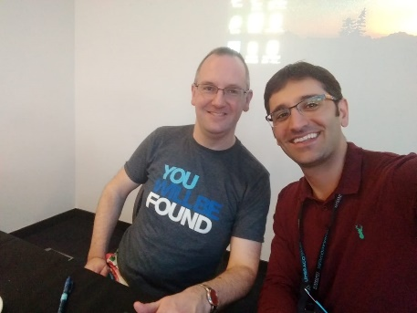
Umbraco Spark 2020
Lunch & Jon Skeet Book Signing
There was nice food&drinks for both meat-eaters and vegeterians, also food for people who have got certain food alergies.
This was a chance to meet new people, also talk to some people that I knew. I was also lucky that Jon Skeet signed my book.
After talking to people; I realised once more that I should get involved more often in the Developer communities as a contributor, participant or a speaker.
One of the things that I do is writing blogs & wikis. I have been a blogger since 2012, and the act of writing and sharing information with others can help lead to deeper understanding and learning.
All these things also help my future self and also others.

Slide 14
Umbraco Spark 2020
Phil Whittaker – Bodyless websites with Umbraco
Phil showed us how driving website builds from the front-end makes sense when building content-led websites.
By giving the front-end control to define what components is needed to create the site, we can free ourselves from pain of integration and let these definitions automate the Umbraco build process entirely.
The process involves completely disconnecting the front-end from Umbraco into what he calls the UI Definition and Delivery applications. Freeing up the front-end to concentrate on developing design systems that can be used to understand and record how different state and context affect the site design integrity.
Integration of front-end build by the Umbraco developer is simplified to (auto)mapping data between Models and Viewmodels, and controlling what context components and pages are rendered in. All managed and controlled by a simple contract that exists per component between the two systems and creates parallel lines directly from the site to the content author.

Slide 15
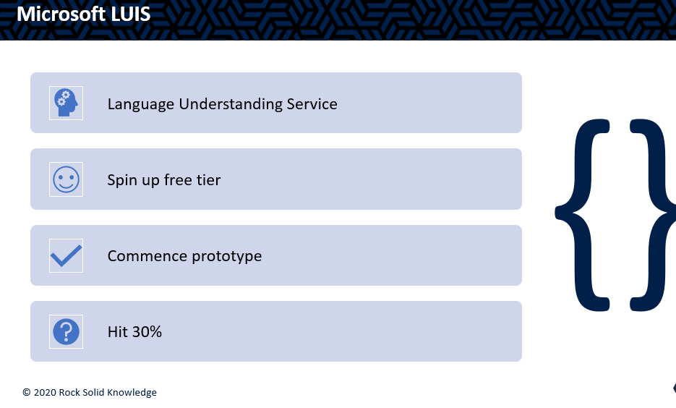
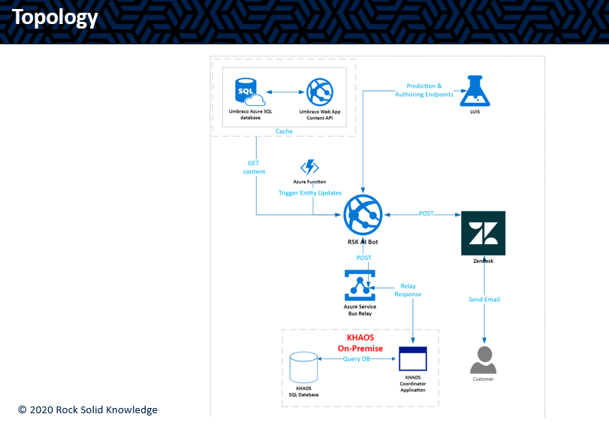
Umbraco Spark 2020
Emma Garland – How to power-up a customer service bot
Emma talked about one of their latest AI projects which uses Mictosoft LUIS and Umbraco to automatically reply standard customer queries, like "Where is my invoice?", "I’d like to cancel my order", etc, on their customer’s website.
Microsoft LUIS is a machine learning-based service for building natural language understanding into apps, bots and IoT devices.
She talked about why they chose to go with these options and also showed us how they used Umbraco for AI data training.

Slide 16
Umbraco Spark 2020
Mikkel Keller Stubkjaer – Not your grandmother’s headless
Mikkel’s approach is that when you publish a page on a site, an event fires which takes the data from that page and transforms it into a model that they then use on the front end – storing it as a JSON somewhere with a Redis cache over it. Then on the front end, they call an API which gets the data from the Redis cache, in the format that they need, and they use it for rendering the page.
The benefits of doing this way are that it is super-fast, higly available, decoupled, and CMS agnostic.
This approach means that they can do the same thing with something like Sitecore or Episerver etc., transforming the data on save into JSON model and storing it in Redis.
A headless CMS is a back-end only CMS build from the ground up as a content repository that makes content accessible via a RESTful API for display on any device. The term "headless" comes from the concept of chopping the "head" (FE website) off the "body"(Back end).

Slide 17
Umbraco Spark 2020
Lee Kelleher – The road to contentment: Making of a killer Umbraco package
Lee talked about his experience with creating Umbraco packages, and he wanted us to understand what he’d gone thru in the last year.
He also talked about some of his latest packages, namely Contentment, and how to use it.
This package is a collection of property editors, which can be very handy.

Slide 18
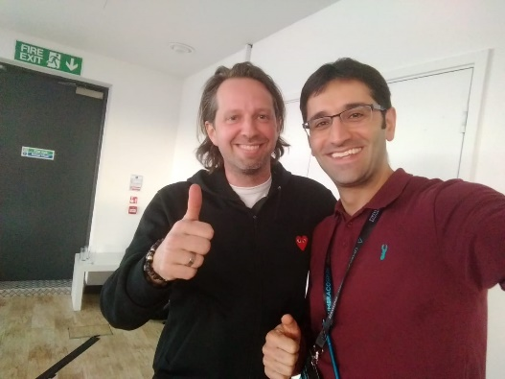
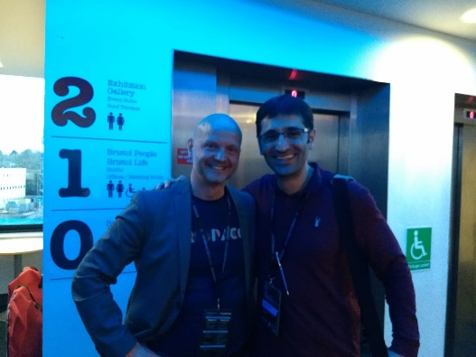

Umbraco Spark 2020
Niels Hartvig – Final talk & Closing drinks and afterparty
Niels, the founder of Umbraco, was the person who did the last talk, and it was about innovation and his innovation experience with Umbraco. It was great fun to listen to him, he is such an easygoing person.
After Niels’ talk, there was a small closing speech by Steve Temple, and then it was time for closing drinks and afterparty.
One great thing about Umbraco Spark is that it is in Bristol! And people who you (might) know are actually the organisers, speakers and participants! It was a great day and I’m already looking forward to next Umbraco event!

Slide 19
Umbraco Spark 2020
Thank you for listening!
Any questions, please do not hesitate to ask.

